Slide 1
HTML
MCNDHS
Ms. Eng

Slide 2
AIM: HOW DO WE SAVE IMAGES TO OUR REPOSITORY BY USING IMAGES TAKEN FROM OUR CELLPHONES?
Do now:
take out YOUR laptop! Open up your repository folder and listen to my instructions!
Daily Grade:
On-time/attendance/not leaving the classroom: 25%
Cellphones: 25%
Notes:25%
Classwork/Homework: 25%

Slide 3
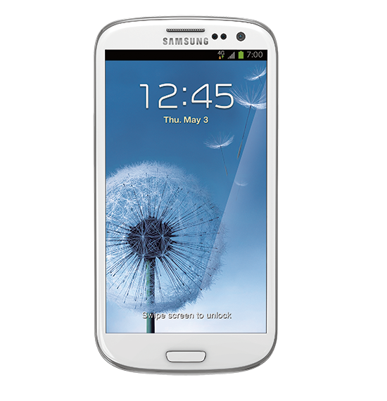
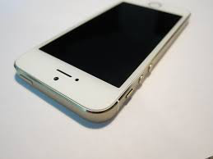
STEP 1:
take out your phone.

Slide 4
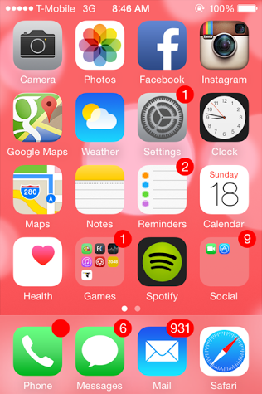
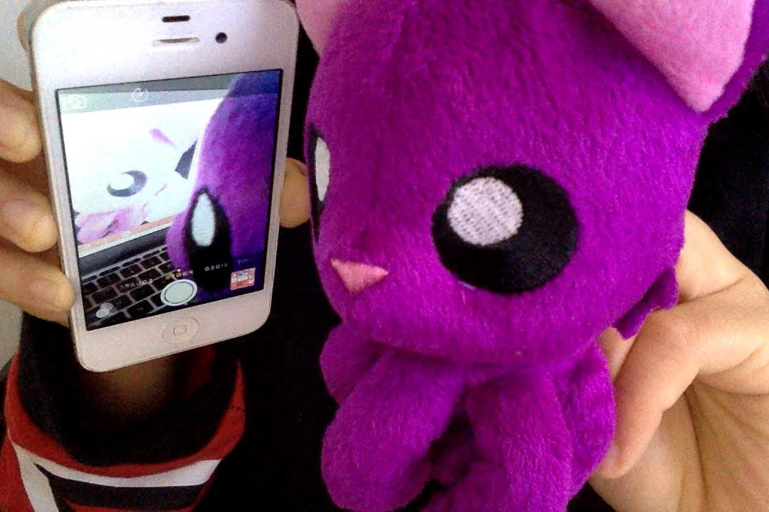
STEP 2:
take a selfie (definition: a picture of yourself)

Slide 5
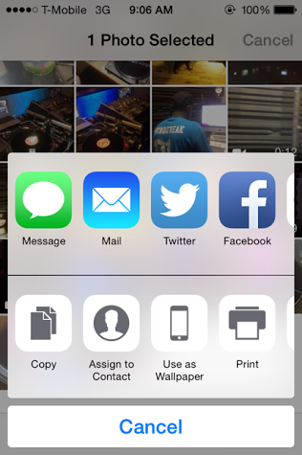
STEP 3:
E-mail the picture to yourself

Slide 6
STEP 4:
open your email from your computer:

Slide 7

STEP 5: DOWNLOAD THE IMAGE AND RENAME

Slide 8
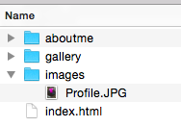
FINAL STEP:
MAKE SURE YOUR IMAGE IS INSIDE YOUR IMAGES FOLDER inside your REPOSITORY!

Slide 9
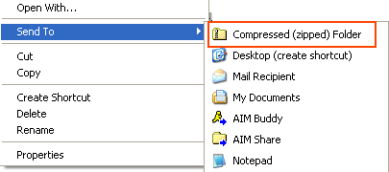
DOUBLE CHECK SAFETY:
compress your repository folder.
Right click on the folder and click compressed zipped

